Slide 1
Inferential statistics
Inferential statistics involves the use of a sample (1) to estimate some characteristic in a large population; and (2) to test a research hypothesis about a given population.
To appropriately estimate a population characteristic, or parameter, a random and unbiased sample must be drawn from the population of interest.

Slide 2
Inferential statistics is used to draw conclusions and make inferences after analyzing data collected in surveys.
Inferential statistics include hypothesis tests and estimation to make comparisons and predictions and draw conclusions that will serve populations based on sample data.

Slide 3
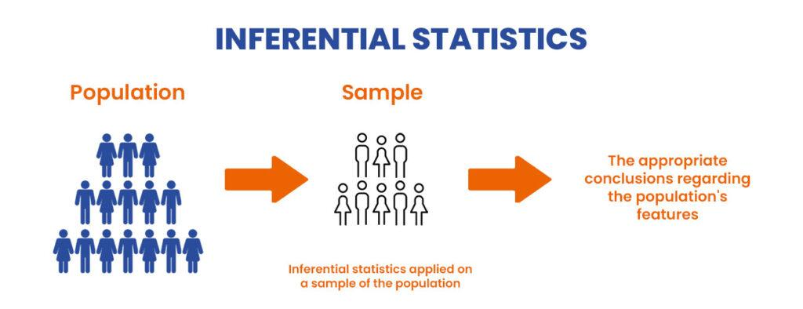

Slide 4
The terms population and sample refer to different things in statistics and are described using different terminology.
For instance, a population is defined as the full collection of individuals from which a sample (i.e., a subcollection of individuals) is drawn.
Suppose we wish to determine the average body mass index (BMI) among female college freshers. It is not necessarily feasible to measure the height and weight of every individual (i.e., conducting a census).
Investigators instead collect a random sample of individuals who are assumed to be representative of the population of interest, measure their heights and weights to calculate BMI, and calculate the mean BMI for that sample with the expectation that it will approximate the mean BMI in the total population (female college freshers).

